Slide 1
MINOR - PROJECT
Presented by : Kavish Thakur , Ikrar Khan

Slide 2
Driver Drowsiness Detection
System Using Convolutional Neural Networks (CNN)

Slide 3
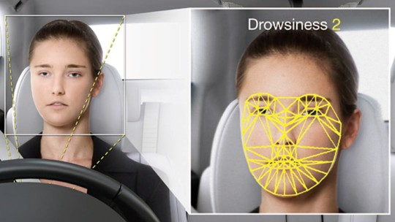
What is an Idea ?
The term Driver Drowsiness Detection system refers to in-vehicle systems that monitor driver and/or vehicle behaviour. These systems monitor the performance of the driver, and provide alerts or stimulation if the driver seems to be impaired. It warns drivers when they are getting drowsy.

Slide 4

Why this Project ?
Car accident is the major cause of death in which around 1.3 million people die every year. Majority of these accidents are caused because of distraction or the drowsiness of driver. Construction of high-speed highway roads had diminished the margin of error for the driver. The countless number of people drives for long distance every day and night on the highway. Lack of sleep or distractions like the phone call, talking with the passenger, etc may lead to an accident. To prevent such accidents we propose a system which alerts the driver if the driver gets distracted or feels drowsy. I think the stats on the accidents due to sleepiness will encourage us to pick this project. Some of the recent stats shows that :

Slide 5
Objective:
To process image of a person driving the vehicle with the help of opencv
To detect the drowsy or active state of a person with the help of convolutional neural network
To send the alert to driver with the help of buzzer with the help of python libraries

Slide 6



About 37 percent or 103 million people have fallen asleep at the wheel, according to the National Sleep Foundation’s [NSF] 2005 poll.
40% of highway accidents occur due to drivers dozing off.
Vehicular crashes result in an estimated 1,550 deaths, 71,000 injuries, and 12.5 billion dollars in monetary losses each year.

Slide 7
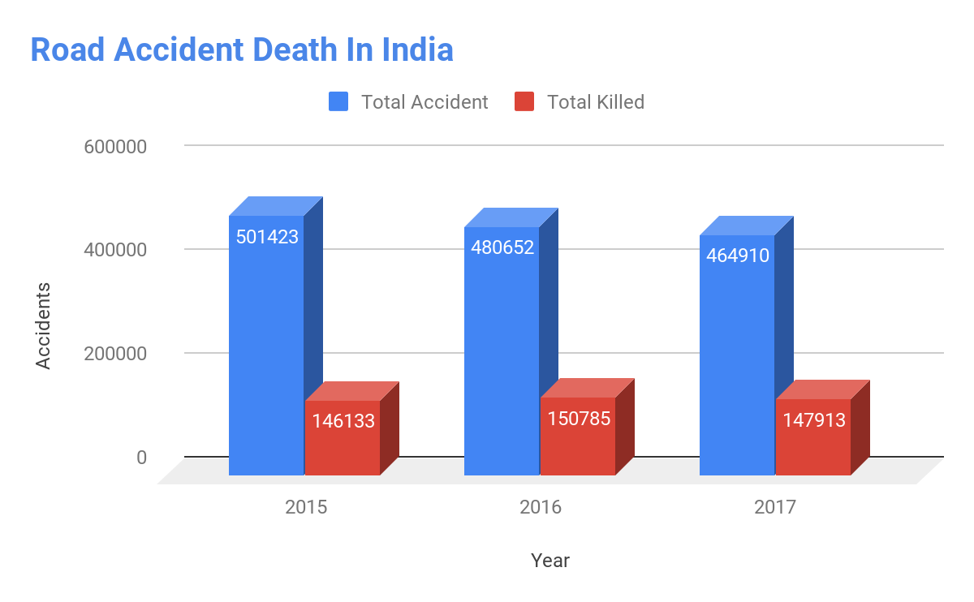
According to the latest data released by road transport and highways ministry, 1,47,913 people were killed in road accidents in 2017, with Uttar Pradesh reporting the maximum number of 20,124 road accident fatalities, followed by Tamil Nadu with 16,157 deaths.

Slide 8
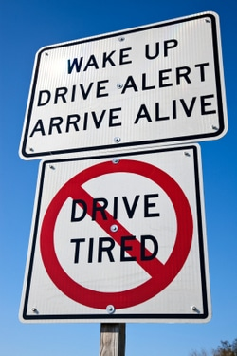
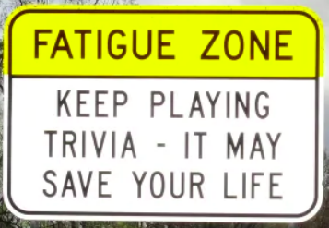
What Has Been Done?
1. Simple driver strategies
Clever signs are one of the most popular ways that the government has used to mitigate drowsy driving (Border Roads Organisation, 2016). Their signs have fun sayings on them intended to catch drivers attention.
Alongside the use of road signs, some popular strategies on an Indian driving forum, Team-BHP, include using a co-driver, and only driving during daylight hours. To stay alert while driving, the same forum recommends keeping fresh air circulating through the air conditioner, keeping the windows rolled up, and listening to fast-paced music (Team-BHP, 2018). Although these strategies are used and recommended by this forum’s drivers, there have been no official studies to prove the effectiveness of these strategies.

Slide 9
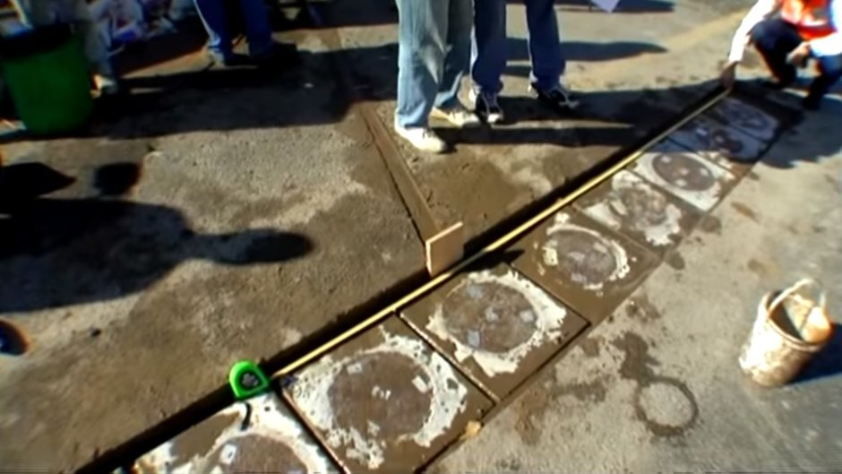
2. Vibrations and alerts
Multiple studies have explored the use of vibrations or alarms to alert drivers of their drowsiness. One particular study of 25 participants was conducted using a prototype steering wheel with vibration capability and a loud buzzer. When a driver displayed signs of drowsiness, the wheel would vibrate and the buzzer would sound, alerting the driver of their drowsy behavior. In general, subjects reported that the buzzer was more effective in alerting drivers, but also significantly more annoying than the vibrations. The study was based on a relatively small sample and produced mostly qualitative data, so the study is relatively incomplete if used on its own to propose a broader solution to drowsy driving. Despite the small sample, the study shows potential options for alert systems.

Slide 10
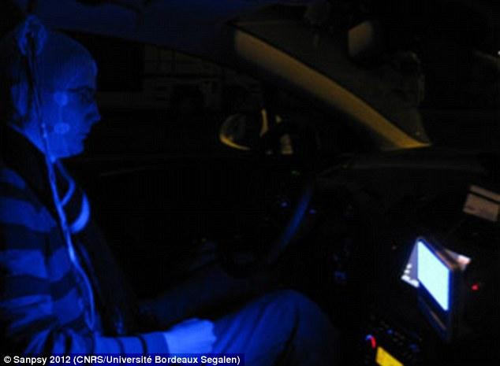
3. Blue light
With the introduction of blue light, the body becomes more alert because the light suppresses the creation of melatonin and shifts circadian rhythms as much as three hours with the right amount of exposure (Harvard Health Letter, 2012). In a study, the introduction of a constant blue light with a wavelength of 468 nm led to a decrease in the amount of times the driver crossed the centerline while driving by around 45%, as compared to the placebo given to participants.
*Placebo- A medicine or procedure prescribed for the psychological benefit to the patient rather than for any physiological effect.

Slide 11
EXISTING SYSTEMS:
Audi: Rest recommendation system
BMW: Active Driving Assistant with Attention Assistant analyses driving behaviour and, if necessary, advises the driver to rest. The advice to take a break is provided in the form of graphic symbols shown on the Control Display.
Bosch: "Driver drowsiness detection" takes input from the steering angle sensor, front-mounted lane assist camera, vehicle speed and turn signal stalk.
Citroën: AFIL/LDWS uses different technologies to monitor the vehicle position on the road. Some models use sensors mounted in front of the front wheels, monitoring the lane markings. Other models use a camera mounted in top center of the windscreen for the same purpose. Both systems alert the driver by vibrations in the driver's seat, on the left or right half of the seat cushion, respectively. Introduced with the 2005 model C4, later followed by 2008 C5 and 2013 C4 Picasso.

Slide 12

How to Implement ?
The techniques that can be used to detect driver’s sleepiness can be divided into three main categories:
The first category includes methods based on biomedical signals, like cerebral, muscular and cardiovascular activity. Usually, these methods require electrodes attached to the driver’s body, which will often cause annoyance to the driver, and cannot be expected to become commercially viable unless ways are found to measure such body signals without electrodes being directly attached to the body.

Slide 13
The second category includes methods based on driver behaviour, which evaluate variations in the lateral position of the vehicle, in the velocity, in the steering wheel angle and in other signals recorded. The advantage of these approaches is that the signal is meaningful and the signal acquisition is quite easy. This is the reason why such systems have entered the commercial market (e.g. for Daimler, Volkswagen, Ford). On the other hand, these systems are subject to several limitations such as vehicle type, driver experience, geometric characteristics, condition of the road, etc. These procedures require a considerable amount of time to analyse user behaviour and, therefore, they do not work with the so called micro-sleeps—when a drowsy driver falls asleep for a few seconds on a very straight road section without changing the vehicle signals.
The third category includes methods based on driver visual analysis using image processing techniques. Computer vision can be a natural and non-intrusive technique

Slide 14



for monitoring driver’s sleepiness from the images taken by some cameras placed in front of the user. These approaches are effective because of the occurrence of sleepiness is reflected through the driver’s face appearance and head/eyes activity. Different kinds of cameras and analysis algorithms have been reported in the literature for this approach: methods based on visible spectrum; methods based on IR camera; and methods based on stereo camera. This method to detect the face of the driver using image processing has accuracy close to 100 percent.

Slide 15
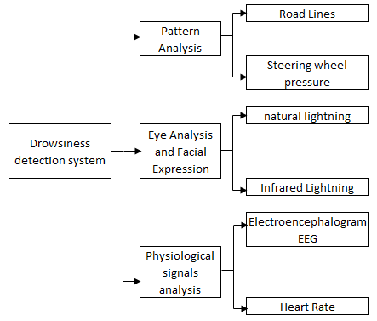

Slide 16
How we’re Implementing ?
To overcome the problem we came up with the solution implemented in the form of image processing. To perform image processing, OpenCV and Cascade Classifier open source libraries are used. Python is used as a language to implement the idea.
A raspberry pi camera is used to continuously track the facial landmark i.e. movement of eyes of the driver. For detection of drowsiness, landmarks of eyes are tracked continuously. Images are captured using the camera at fix frame rate of 20fps. These images are passed to image processing module which performs face landmark detection to detect drowsiness of driver using Convolutional Neural Network. If the driver is found to be sleepy then a voice (audio) alert is provided and a message is displayed on the screen.

Slide 17
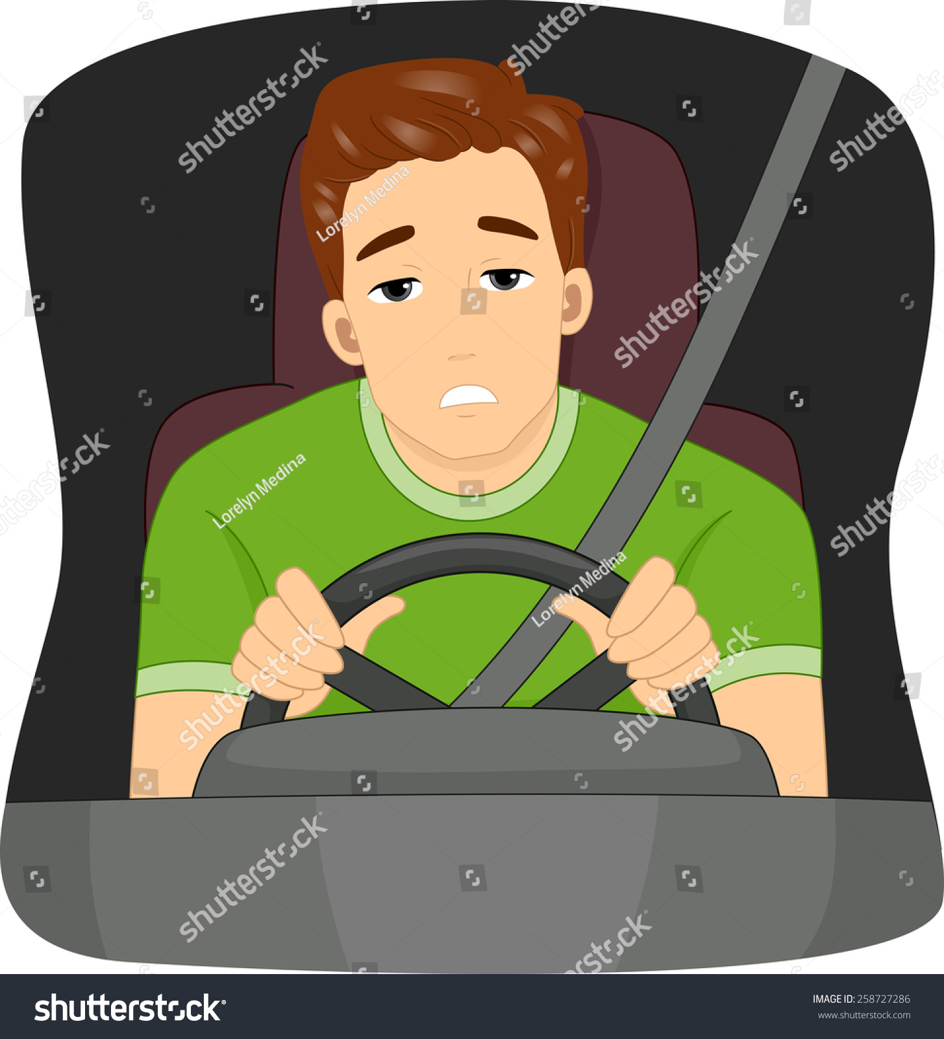

If eyes of drivers are closed for a threshold period of time then it is considered that driver is feeling sleepy and corresponding audio alarm is used to make the driver aware.
All this functionality is then implemented with the help of raspberry pi, an audio interfacing is used to provide audio feedback to the user and a small LED screen is used to display the message.

Slide 18
What Is a Convolutional Neural Network?
A convolutional neural network (CNN or ConvNet) is one of the most popular algorithms for deep learning, a type of machine learning in which a model learns to perform classification tasks directly from images, video, text, or sound.
CNNs are particularly useful for finding patterns in images to recognize objects, faces, and scenes. They learn directly from image data, using patterns to classify images and eliminating the need for manual feature extraction.
Why CNN ?
CNNs eliminate the need for manual feature extraction— the features are learned directly by the CNN.
CNNs produce state-of-the-art recognition results.
CNNs can be retrained for new recognition tasks, enabling you to build on pre-existing networks.

Slide 19
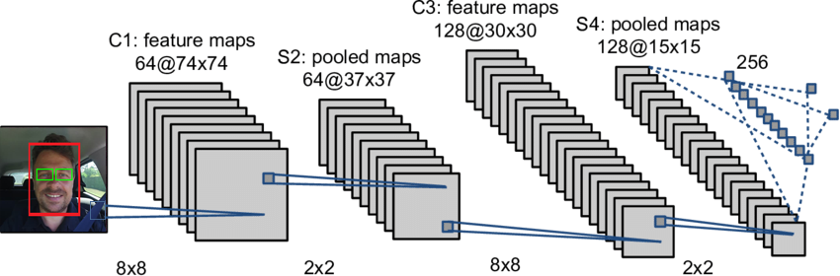
Architecture of Convolutional Neural Network

Slide 20
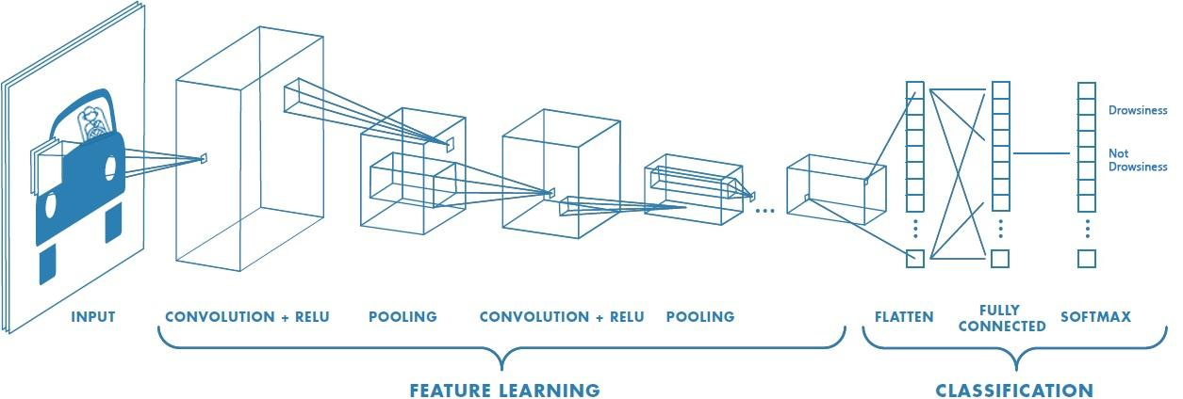
How CNNs Work?
A convolutional neural network can have tens or hundreds of layers such that each layer can learn to detect different features of an image. Filters are applied to each training image at different resolutions, and the output of each convolved image is used as the input to the next layer. The filters can start as very simple features, such as brightness and edges, and increase in complexity to features that uniquely define the object.

Slide 21
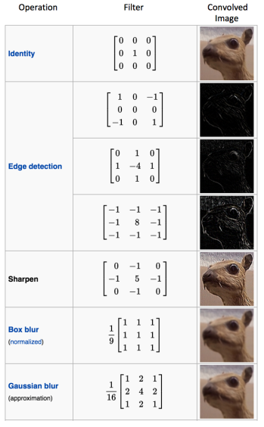
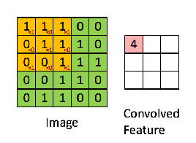
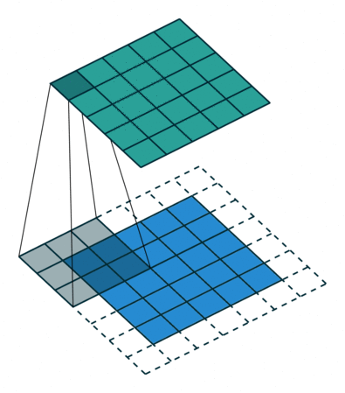

Slide 22
Why CNN is So Effective ?
CNN Classifier | Other Classifiers (svm, logistic regression etc.)
It automatically detects the important features without any human supervision. | It do not detect features automatically . Features are define to classifier.
It has very small number of parameters . | It has very large number of parameters. Every pixel is a parameter.
CNN is also computationally efficient. It uses special convolution and pooling operations and performs parameter sharing. | It is computationally costly . It has no parameter sharing operation.
CNN accuracy increases with increasing datasets. | Accuracy remain constant in increasing datasets.
CNN can be run low processing power devices e.g raspberry pi, mobile devices. | It needs high processing power devices.

Slide 23
Block Diagram :
Image
Processing
Camera
Raspberry
Pi
Buzzer
Power Supply

Slide 24
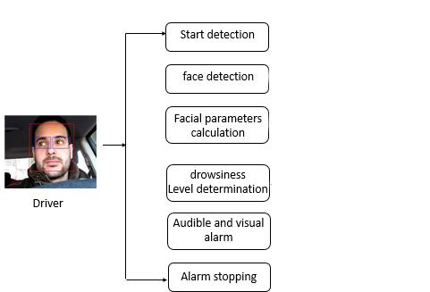
Flowchart

Slide 25
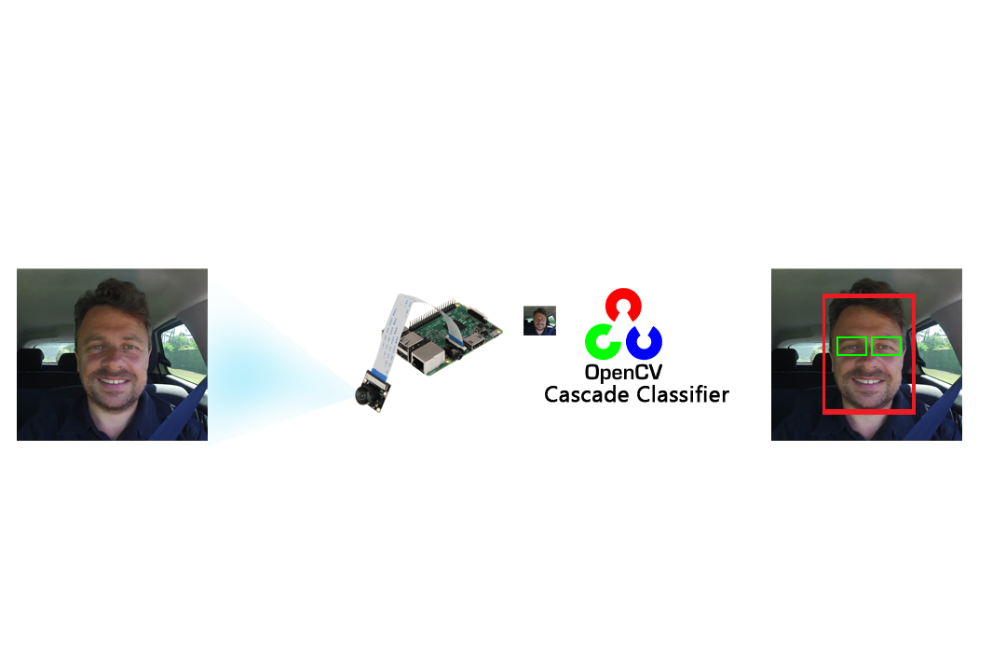
Processing
Step 1:
Detecting Face & Eyes
Image is taken from camera .
OpenCV and Cascade Classifier detect the face and eyes which is ROI (region of interest) and Filtered image is send to Convolution Neural Network Classifier.
Raw image
Filter Image

Slide 26
Step 2 :
Convolutional Neural Network Classifier
The main purpose of the convolution step is to extract features from the input image.
The convolutional layer is always the first step in a CNN.
In a convolutional layer, neurons only receive input from a subarea of the previous layer.
We have an input image, a feature map and feature detector.
We take the filter and apply it pixel block by pixel block to the input image.
It is done through the multiplication of the matrices.
At the end of Convolutional Neural Network predict the probability of Drowsiness.

Slide 27
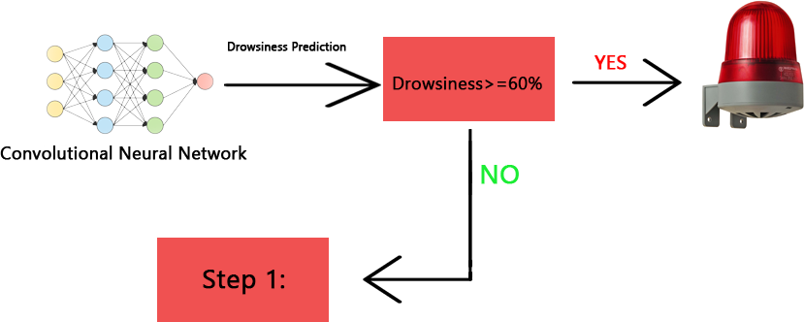
Step 3 :
Drowsiness Alarm
If Drowsiness Detection probability is above than 60% then alarm will beep till driver off it.
If Drowsiness Detection probability is less than 60% then process back to step 1 i.e. continuous scanning of driver’s face.

Slide 28

What are the Advantages?
Quick detection of drowsiness
Decrease in the road accidents
System implemented without the need of database storage
No wires, monitor or other devices are to be attached or aimed at driver
Due to unobtrusive nature of this method they are more practically available

Slide 29

What are the Limitations ?
Driver Drowsiness Detection systems can only warn the driver that he is drowsy. It is the responsibility of the driver to take a break and to ensure that he starts driving again after attaining sufficient level of attention.
Image face recognition and light source are the main challenges of this technology.
There should not be any reflective object behind the driver.
The decision is based on the single sensor i.e. camera.

Slide 30

References
Websites:
[1] https://towardsdatascience.com/wtf-is-image-classification-8e78a8235acb
[2] https://medium.com/@RaghavPrabhu/understanding-of-convolutional-neural-network-
cnn-deep-learning-99760835f148
[3] https://medium.com/@tifa2up/image-classification-using-deep-neural-networks-a-
beginner-friendly-approach-using-tensorflow-94b0a090ccd4
[4] https://www.mathworks.com/solutions/deep-learning/convolutional-neural-network.html
[5] https://www.ncbi.nlm.nih.gov/pmc/articles/PMC3571819/
[6] https://www.medindia.net/patientinfo/drowsy-driving.htm#
[7] https://www.ncbi.nlm.nih.gov/pmc/articles/PMC3571819/
[8] https://www.dailymail.co.uk/sciencetech/article-2238581/How-blue-light-
car-good-coffee-keeping-alert-wheel.html

Slide 31
References
[9] https://timesofindia.indiatimes.com/india/india-way-off-road-safety-targets-for-
2020-road-accidents-still-kill-over-a-lakh-a-year/articleshow/65765549.cms
[10] https://en.wikipedia.org/wiki/Driver_drowsiness_detection
[11] architecture-of-convolutional-neural-networks-simplified-demystified

